Slide 1

Bilha Muturi | Naima Hassan | Pauline Brown

Slide 2
Problem Definition
Water scarcity affects 40% of people around the world.
Water demand grows due to growth in population and industries
It’s projected that by 2050 the demand for water will surpass its supply globally
In Nairobi:
Total demand of water - 650000 units/day
Total supply of water - 482940 units/day
Sources: UN and World Wide Fund

Slide 3
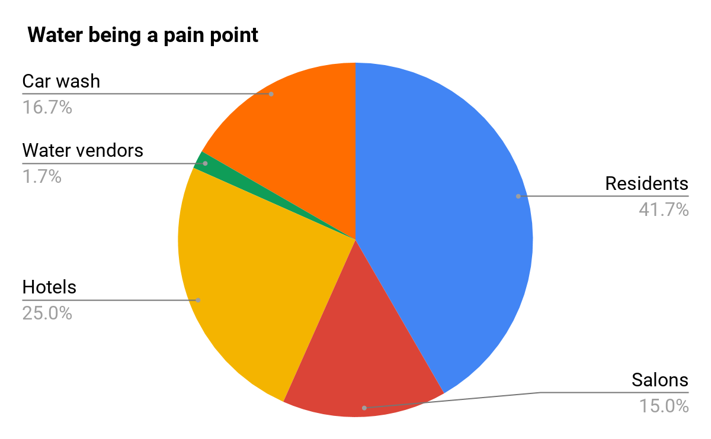

Notes:
May require more than one slide

Slide 4
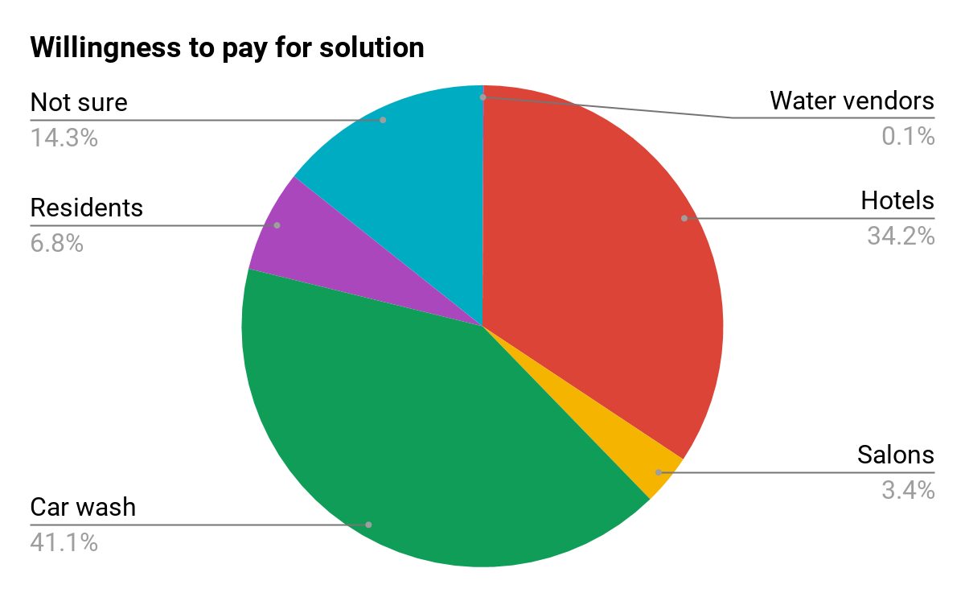
Notes:
May require more than one slide

Slide 5

Our proposed solution

Slide 6
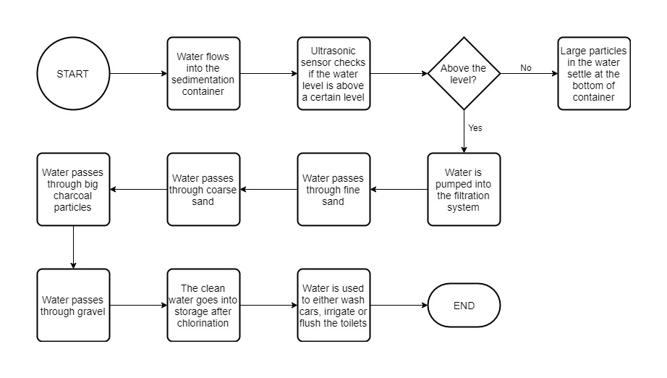

Slide 7
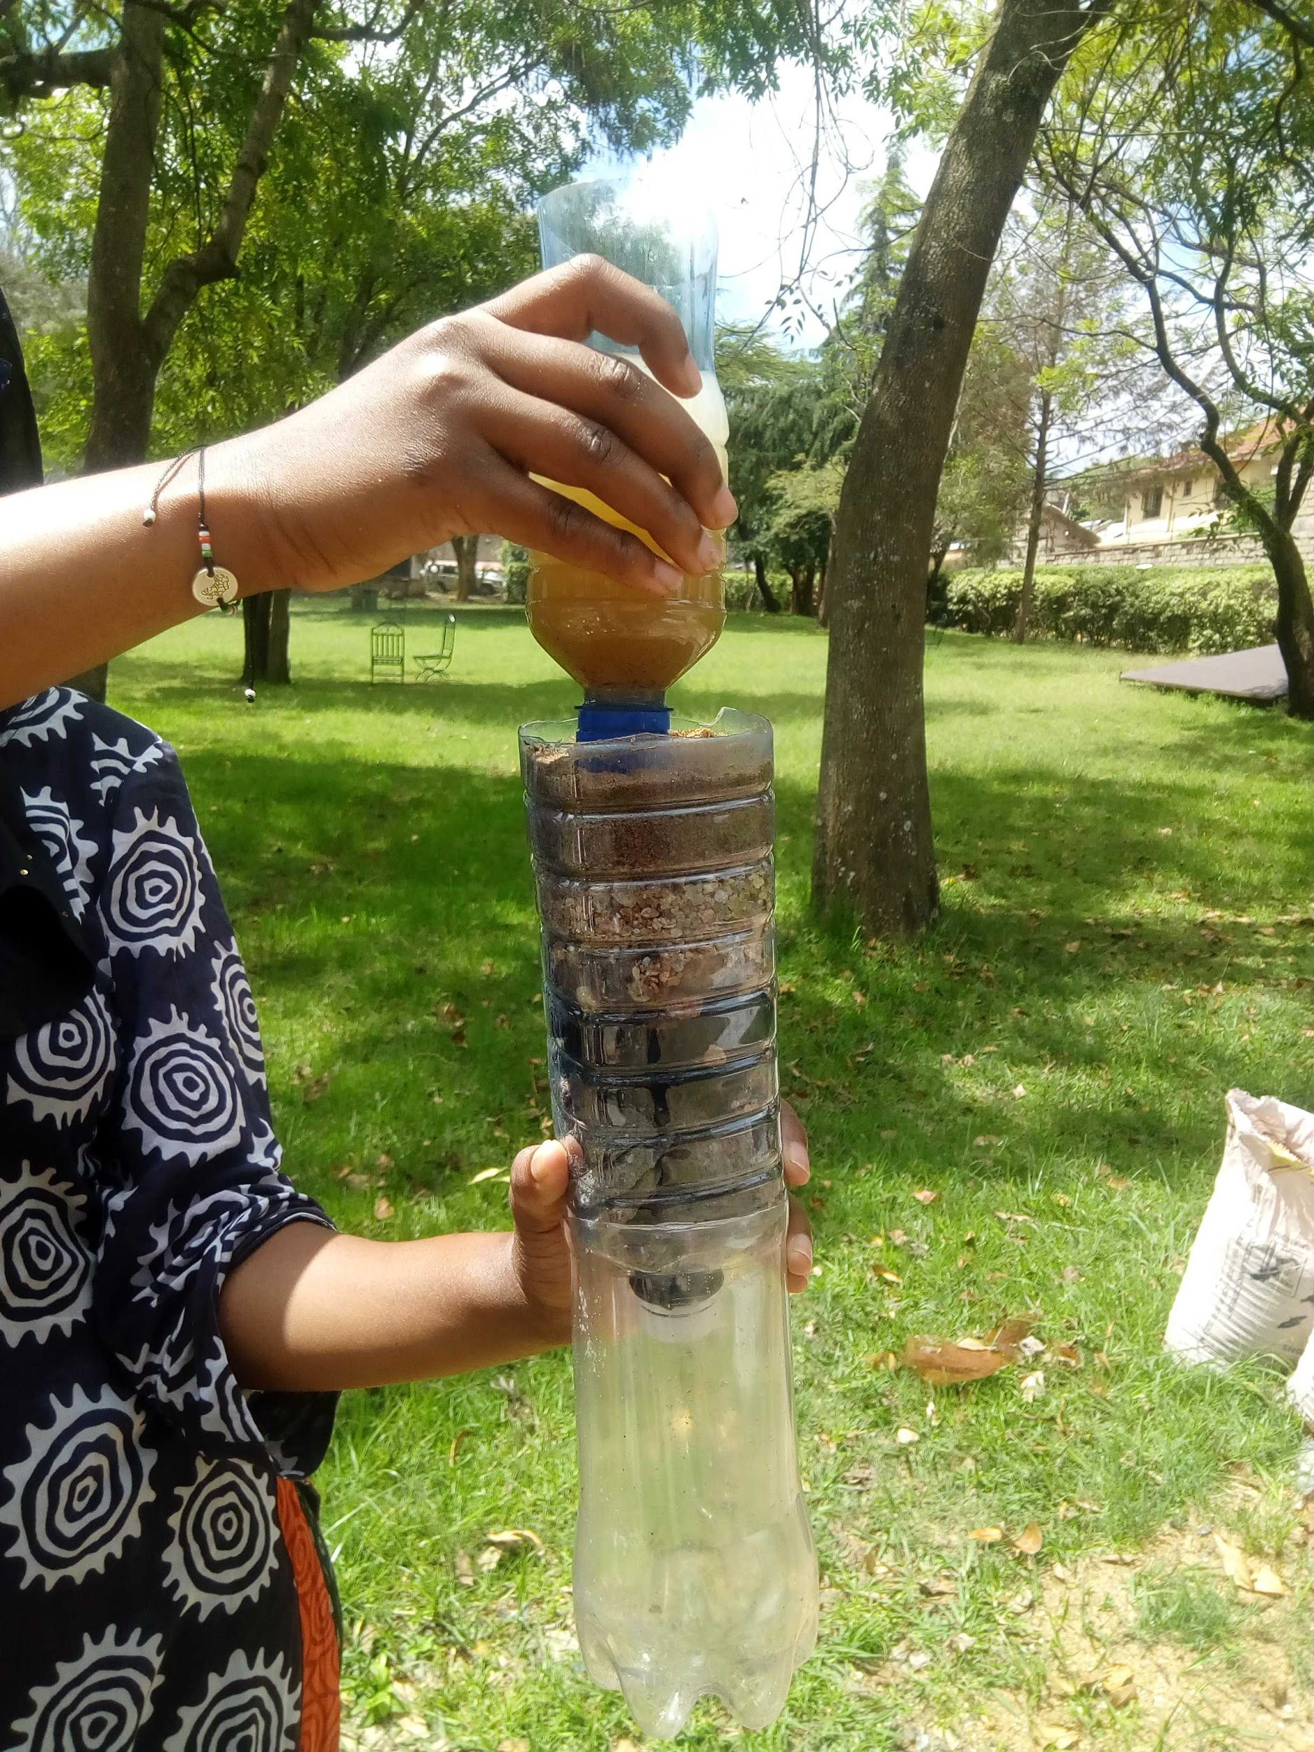
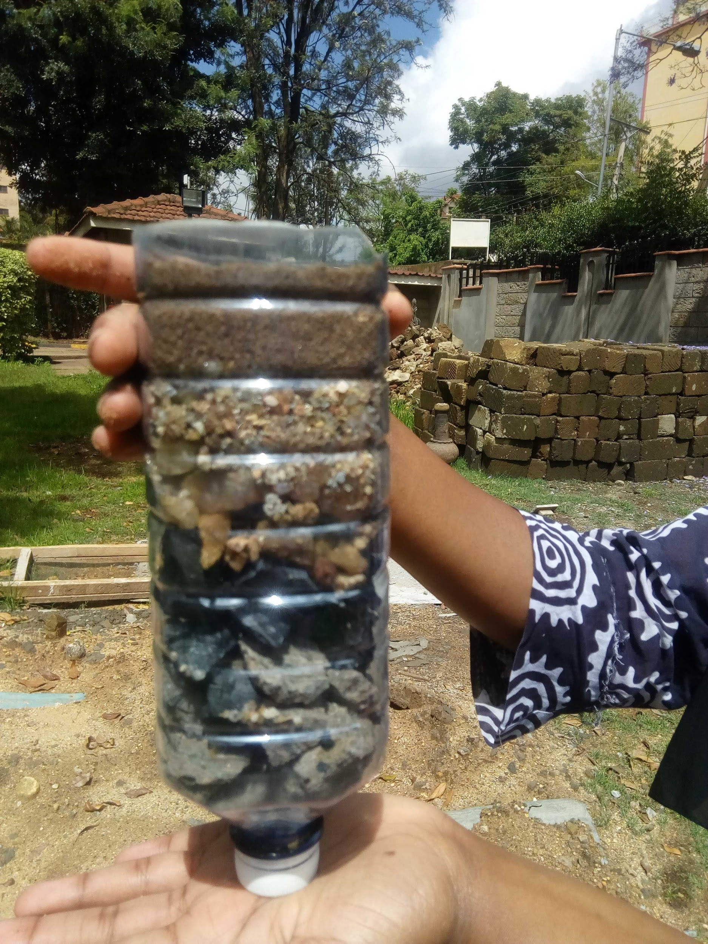

Slide 8
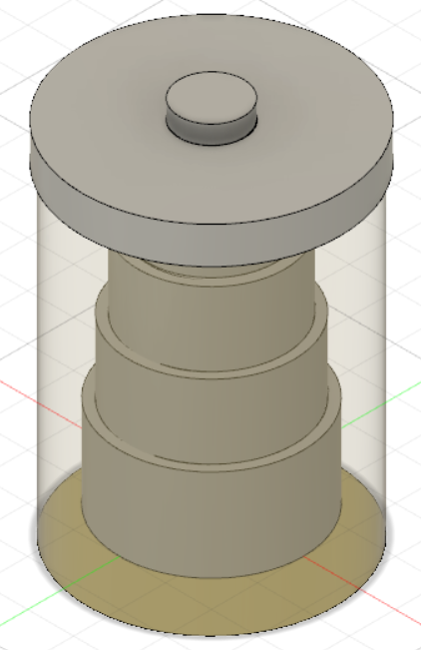
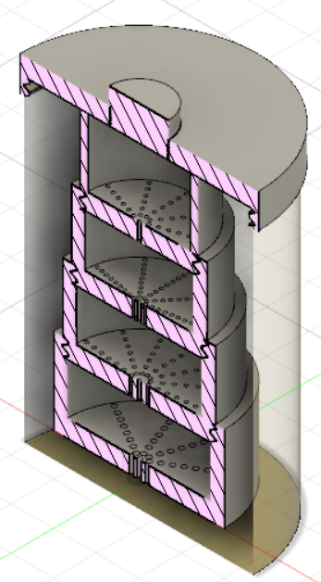
Fusion Design
Notes:
May require more than one slide

Slide 9
Logo Design
Mind map
Blue
Customers
Customer
AquaPure
Business
Environment
Notes:
May require more than one slide

Slide 10
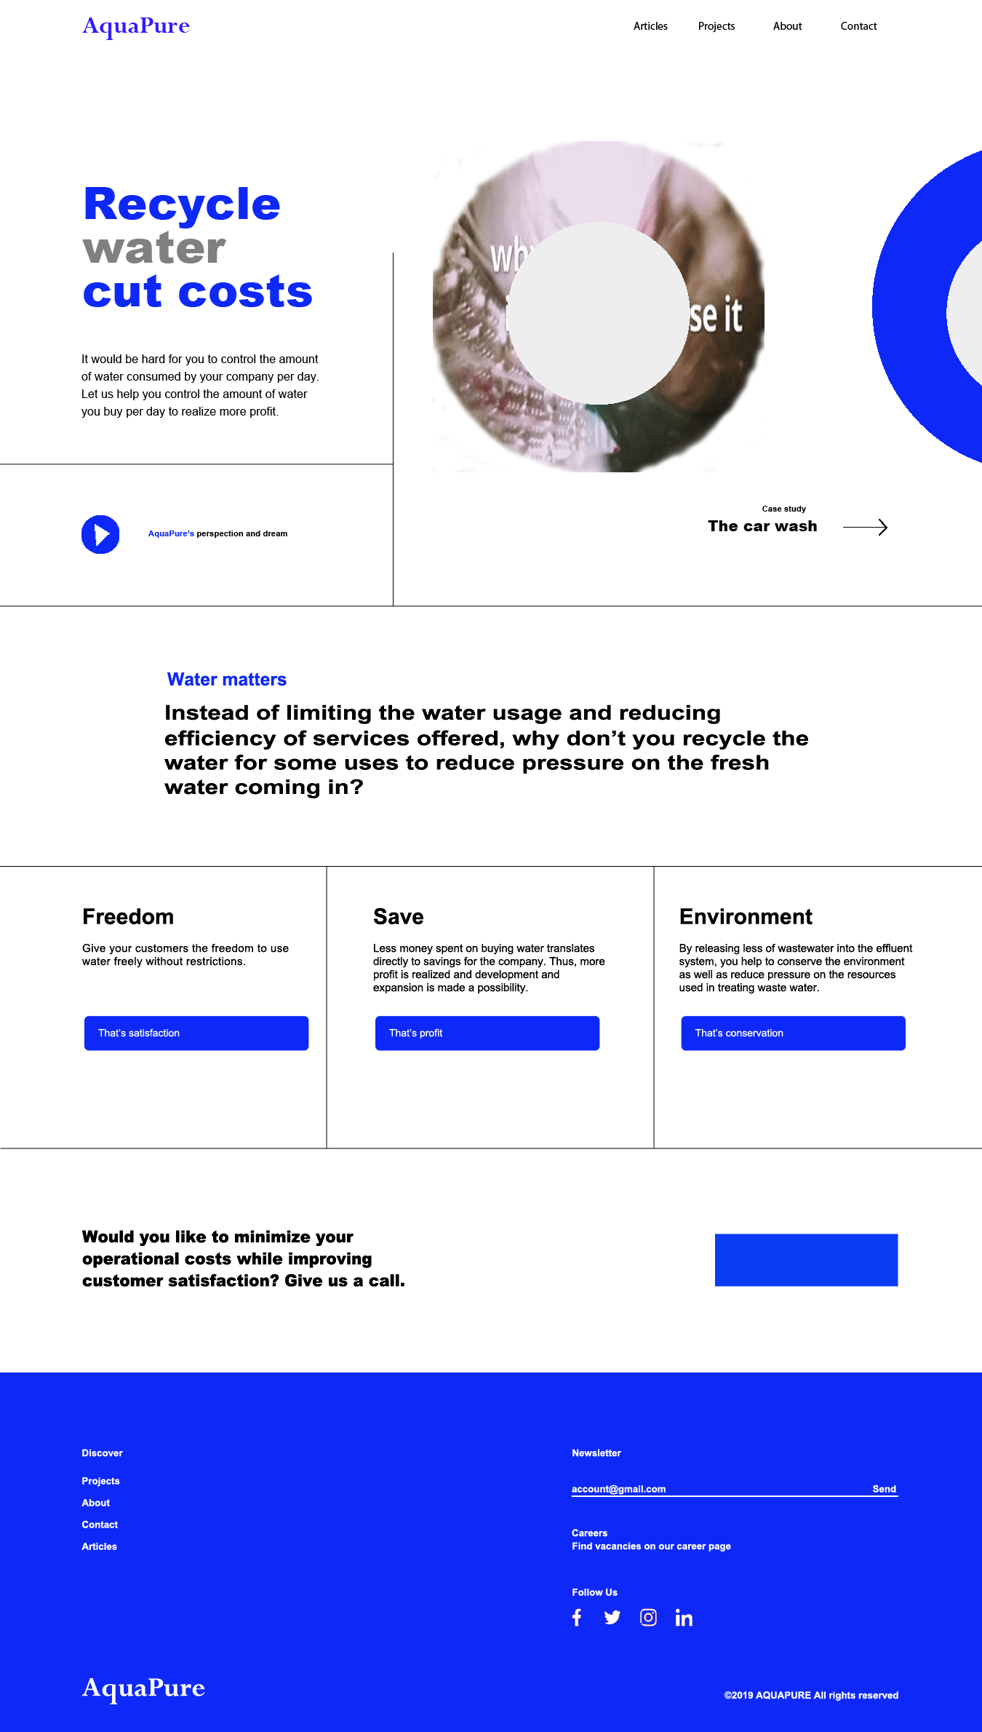
Website Mockup

Slide 11
Team
Bilha Wanjiku
Scrum master
Naima Hassan
Product Owner
Pauline Brown
Product Manager

Slide 12



Slide 13


